Slide 1
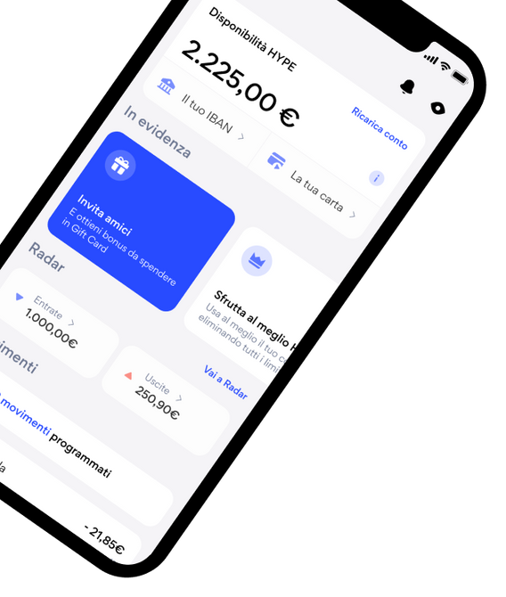
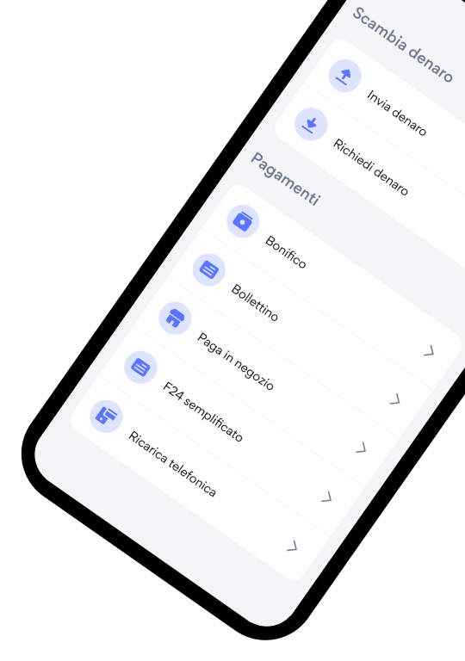
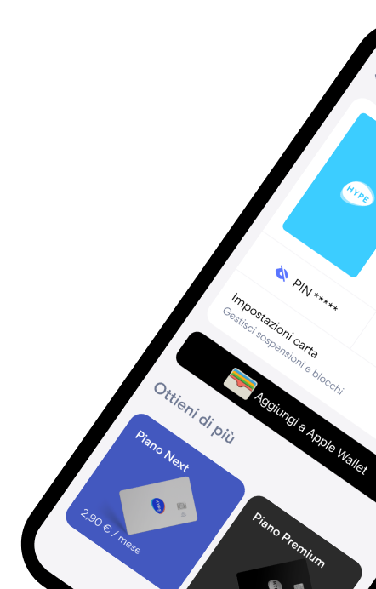

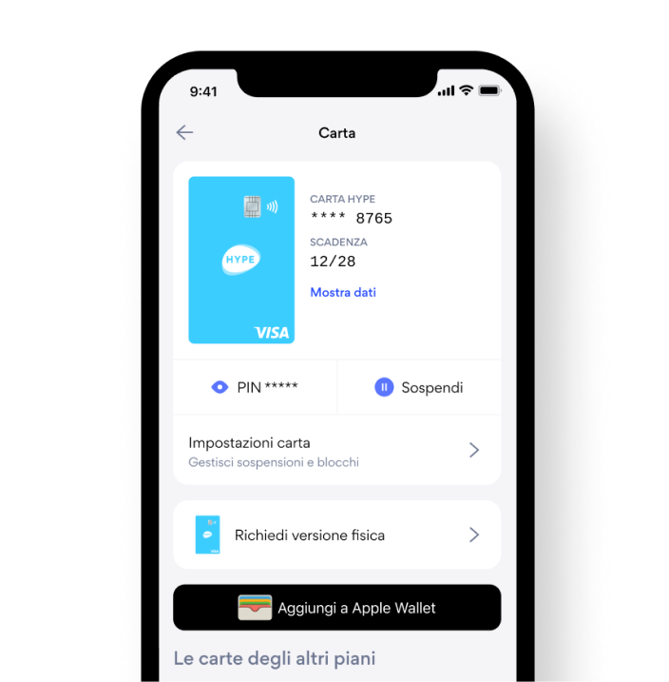

in App Reviews
TOPIC DETECTION
A Data-Driven Solution for HYPE
Alessia Ciccaglione - s344499
Amirhossein Lotf Ranaei - s323336
Sonia Foco - s343043

Slide 2


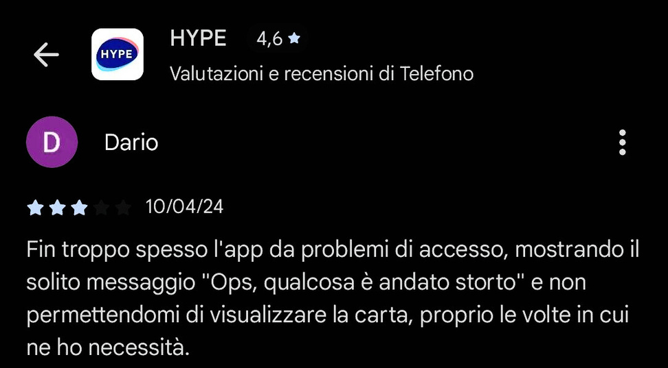

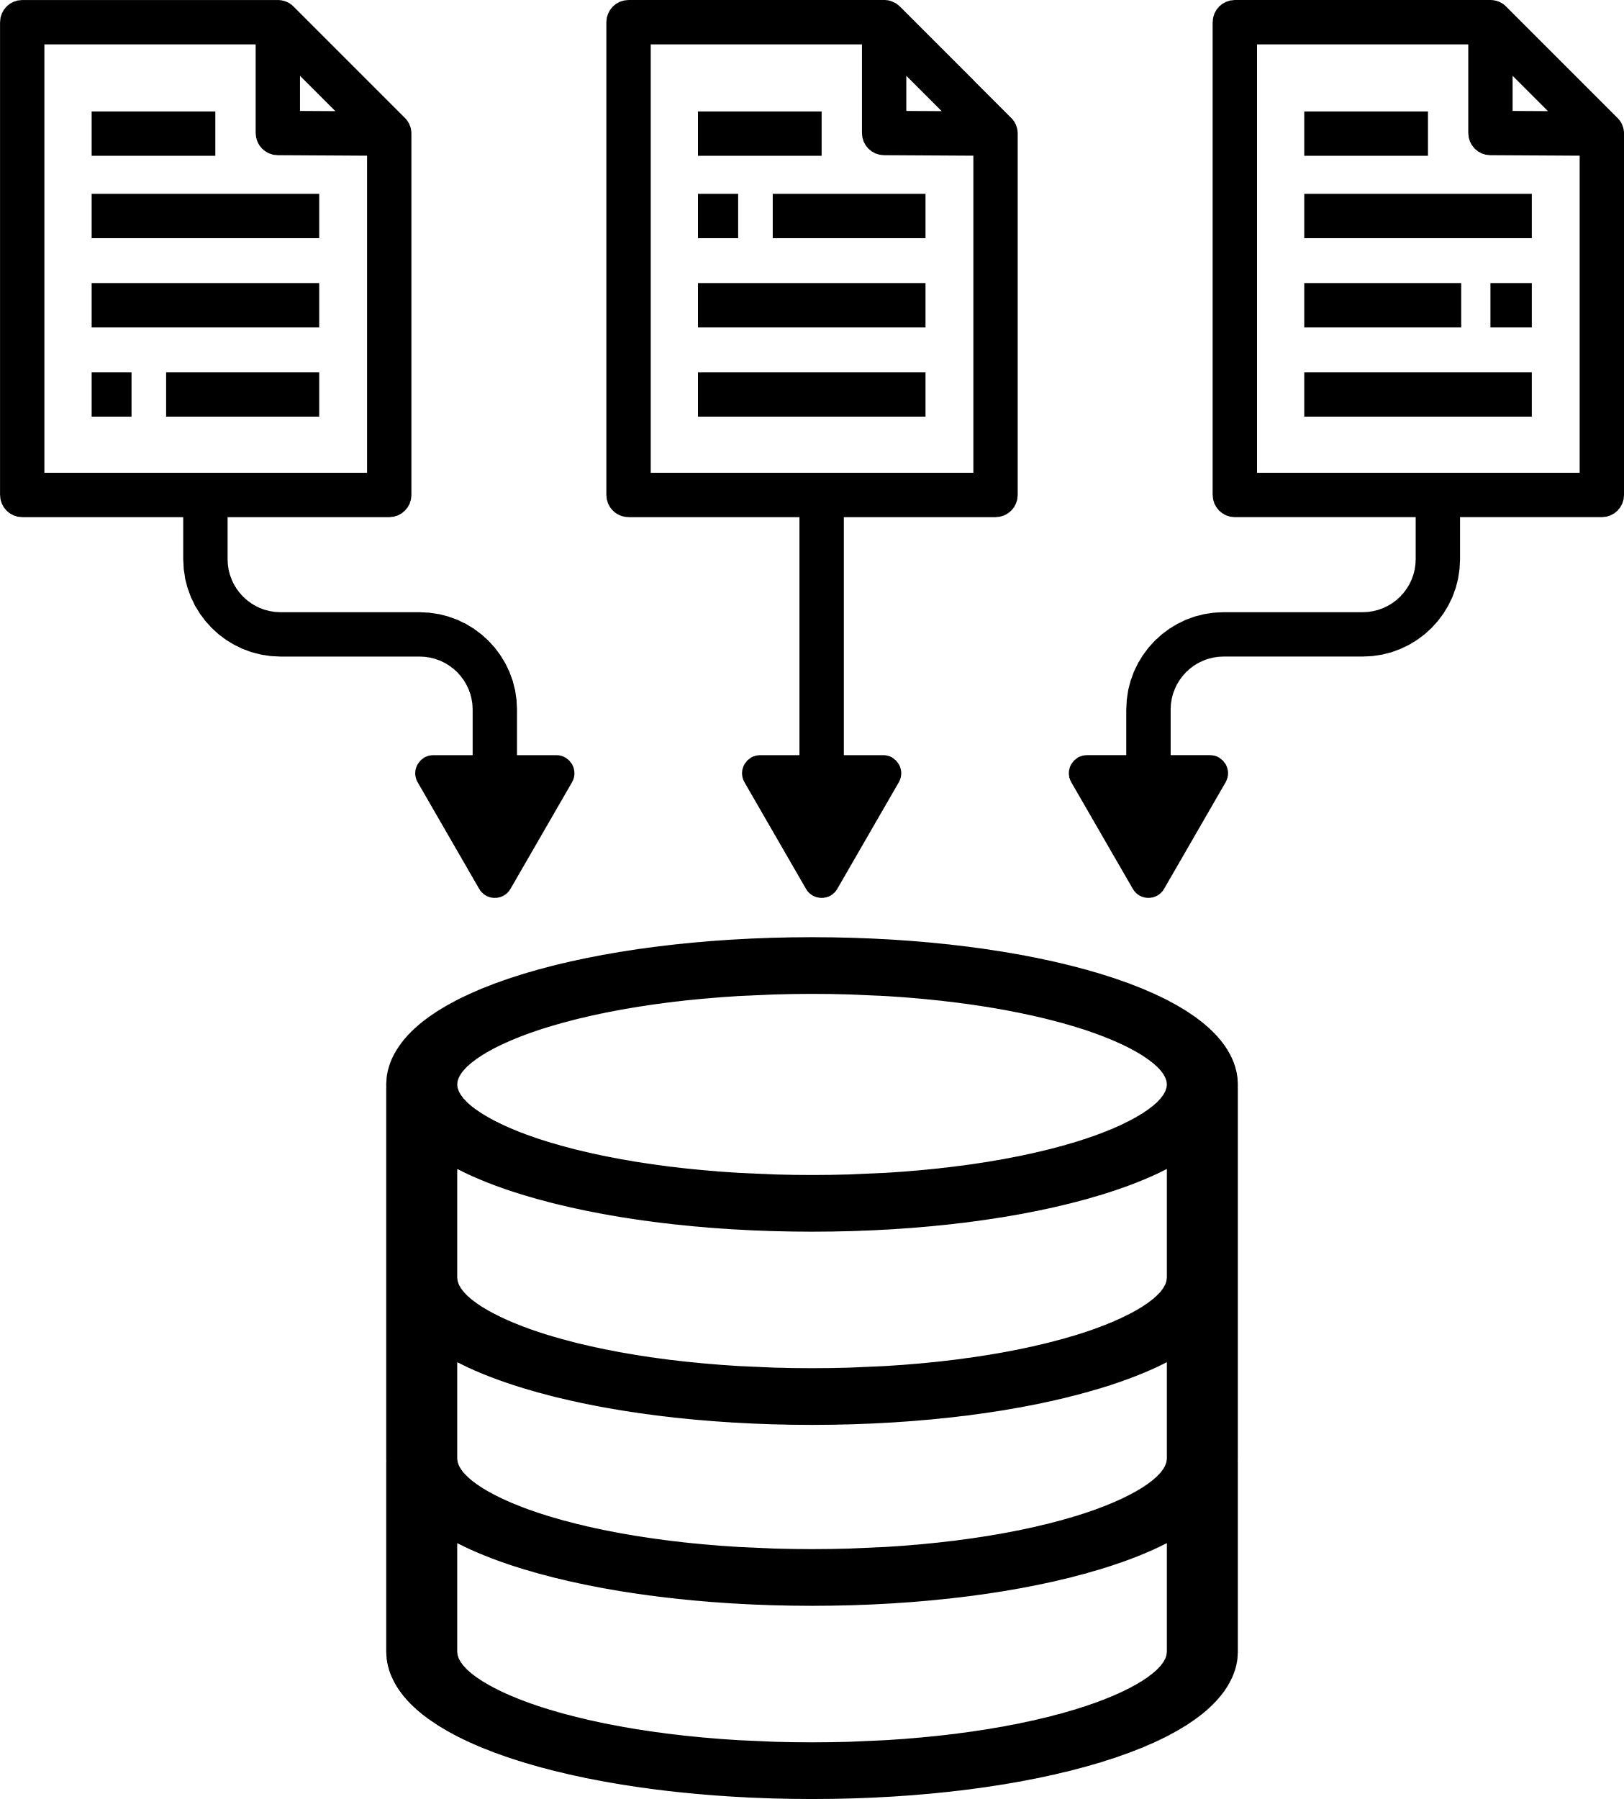
OBJECTIVES of
Our Solution :
KEY FEATURES
BENEFITS
Automatically analyzes every HYPE app review
Detects negative topics (bugs, complaints, usability issues)
Identifies recurring problems and emerging trends
Tags each review consistently
Faster insights for the Research & Customer Insight team
Reduced manual effort
Summarizes large volumes of feedback
Improved visibility on customer pain points
AI TOOL
FOR FEEDBACK AUTOMATION
6150 records

Slide 3
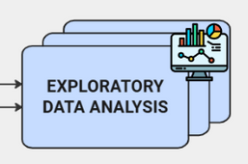
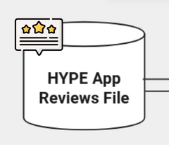
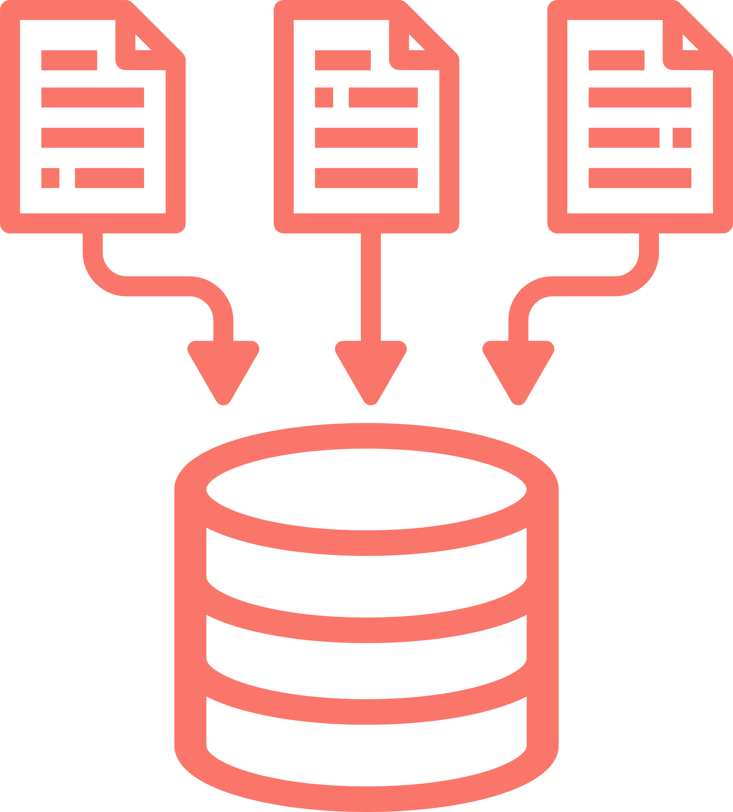
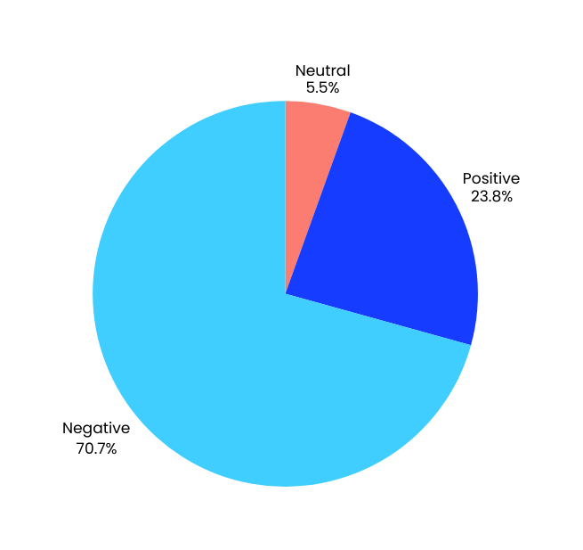


Introducing the
DATASET
REAL USER REVIEWS
Ambiguous meaning
Multi-label reviews
Multilingual content
Off-topic reviews
Copy-pasted content
Spam and low-quality reviews
Small size Labelling errors

Slide 4




Defining the
VALUE PROPOSITION
By using automated NLP, we enhance feedback analysis efficiency, reduce manual effort, and accelerate decision-making. Real-time insights from user reviews enable data-driven product improvements, driving growth and fostering a more sustainable business environment.
By utilizing cutting-edge AI technology, we automate topic detection, improving operational efficiency and modernizing product development processes. This supports the growth of a more data-driven and technologically advanced infrastructure.
4

Slide 5



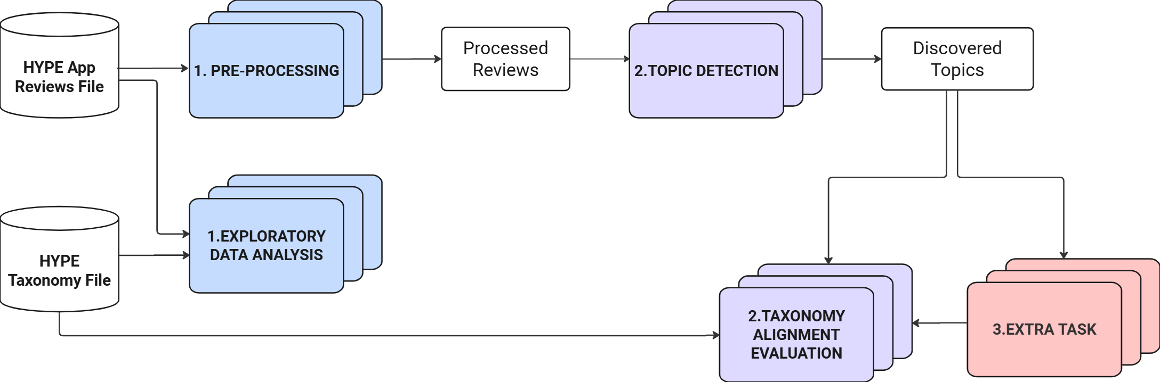




METHODOLOGY OVERVIEW
Functional Diagram
3-STEP SYSTEM OVERVIEW

Slide 6


HYPOTHESIS AND RESEARCH QUESTIONS
Driving Our Investigation
RQ1 — Does machine translation affect the semantic quality of topic detection on multilingual app reviews?
RQ2 — How do different stopword-removal strategies affect the performance of embedding-based topic modeling on app reviews?
RQ3 — Which configuration of BERTopic’s modular components (embeddings, dimensionality reduction, clustering, and topic representation) yields the best topic quality?
RQ4 — Do semi-supervised topic models outperform unsupervised approaches in identifying relevant issues from app reviews?
RQ5 - Do embedding-based semantic similarity methods provide reliable mappings between data-driven topics and the existing taxonomy of app issues?

Slide 7
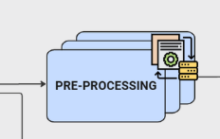











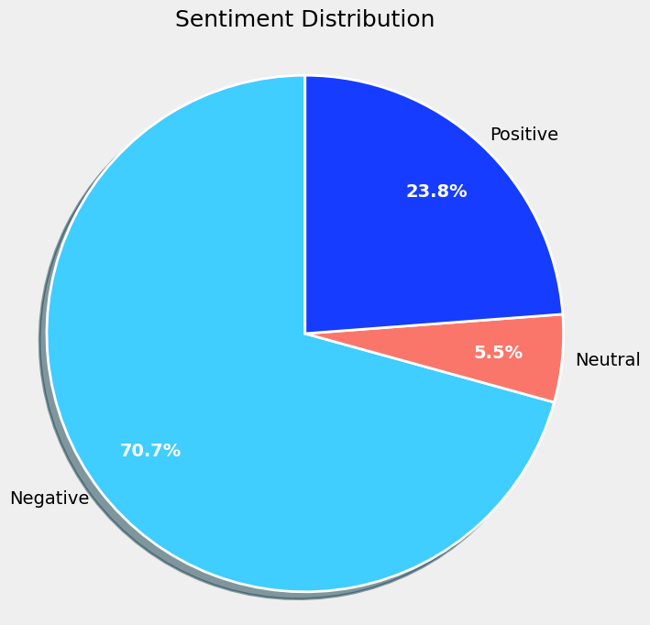


PRE-PROCESSING
Workflow
Italian
Translation
Remove URLs,
emoji & mentions
Reclassification of Neutral Reviews
Redundant Reviews Removal
01
02
03
04
Aa
05
06
07
08
Normalize Spacing & Repeated Characters
Lowercasing sentiment column
Remove Meaningless Reviews
Multi-Word Expression
05
07
Neutral ≠ always problem-free
After comparing TF-IDF, SBERT, and E5, we opted for a basic TF-IDF approach.
222 Negative
115 Positive

Slide 8
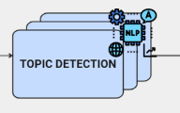

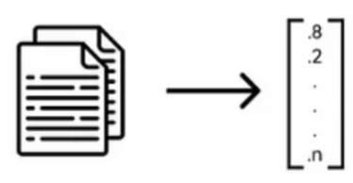
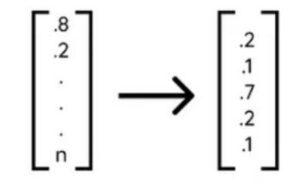

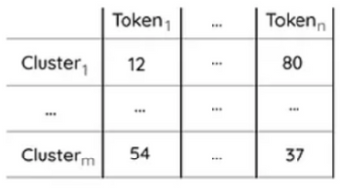
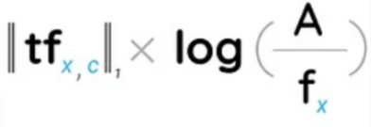
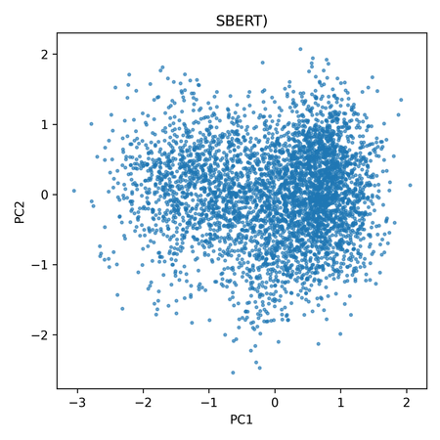
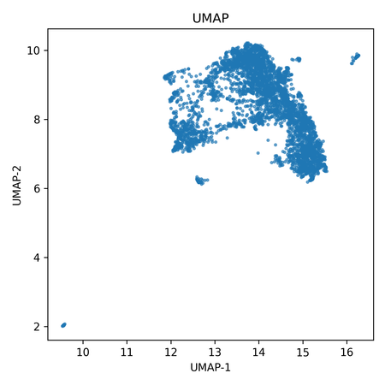
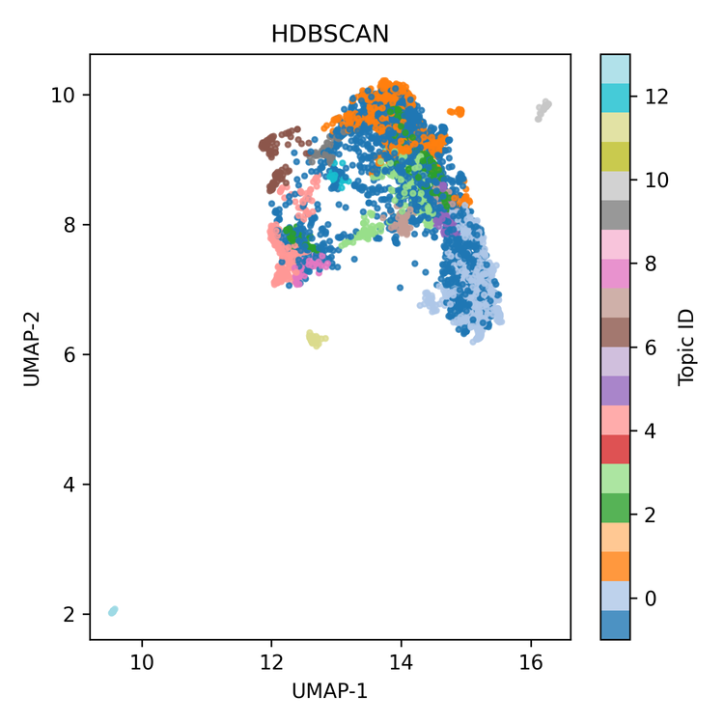
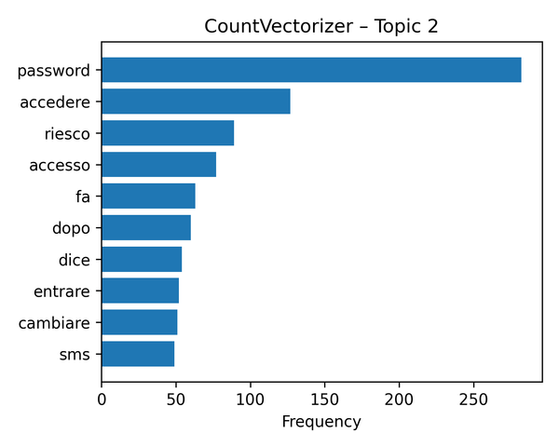
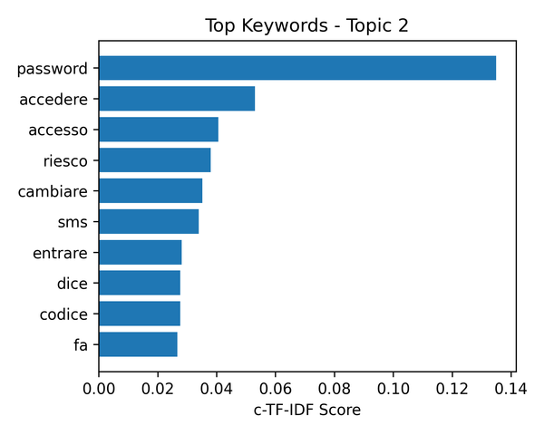
Topic Detection
BERTopic
LLM-based description of the
topics
SBERT
UMAP
HDBSCAN
CountVectorizer
c - TF-IDF
Embedding
Extraction
Dimensionality
Reduction
Clustering
Bag Of words
Topic Representation
For its enterprise application, the system allows the final number of topics to be manually defined by the user directly or through the topic reduction function, after a qualitative evaluation of the initial BERTopic output.
“Login Issues”

Slide 9
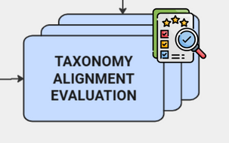
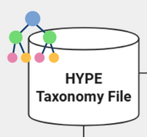
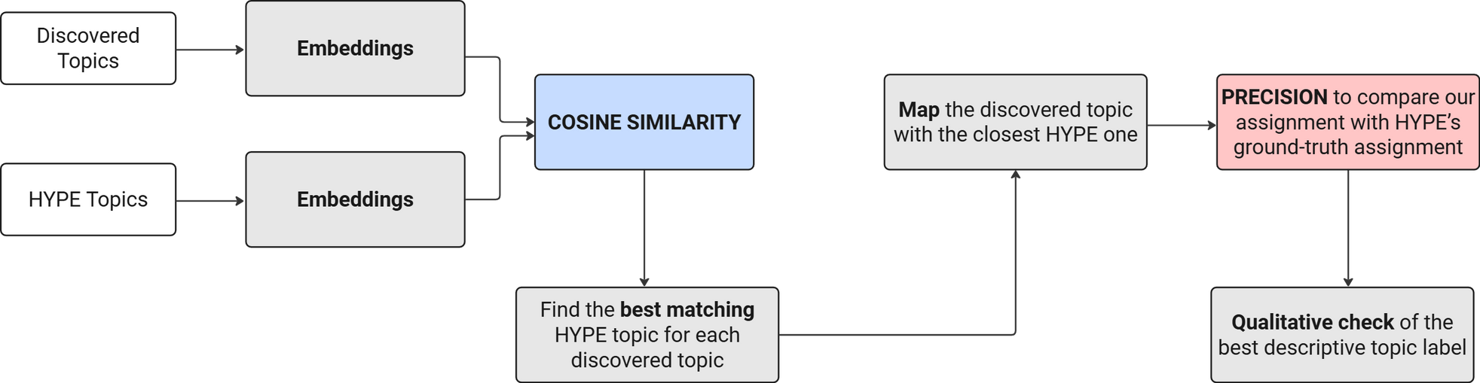
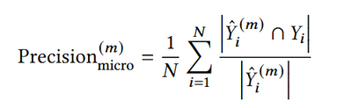
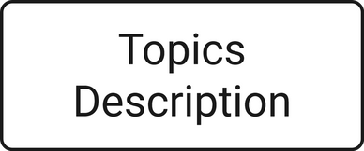

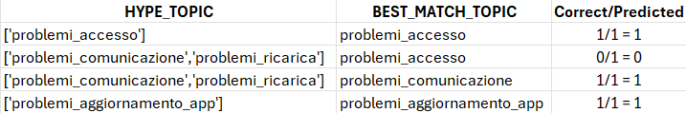
Aligning Topics to the
HYPE TAXONOMY
TAXONOMY ALIGNMENT
EVALUATION AND COMPARISON
Precision = ¼ (1+0+1+1) = 0.75

Slide 10



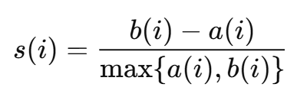
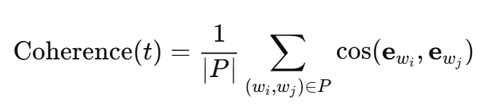


EXPERIMENT & RESULT
General Evaluation
METRICS
Topic Coherence Score
Silhouette Score
Measures how well documents are clustered by comparing the average intra-cluster distance a of each document with the average inter-cluster distance b.
Measures the semantic consistency of topics by computing, for each topic t, the average cosine similarity between the embeddings ewi and ewj​​ of all pairs of its top representative words.
Measures how different topics are from each other by
computing the ratio between the number of unique words W and the total number of representative words across
all topics T, considering the top K=10 words per topic.
Topic Diversity Score

Slide 11

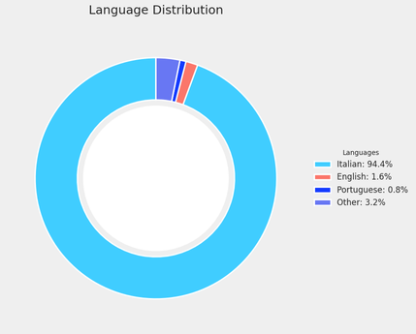




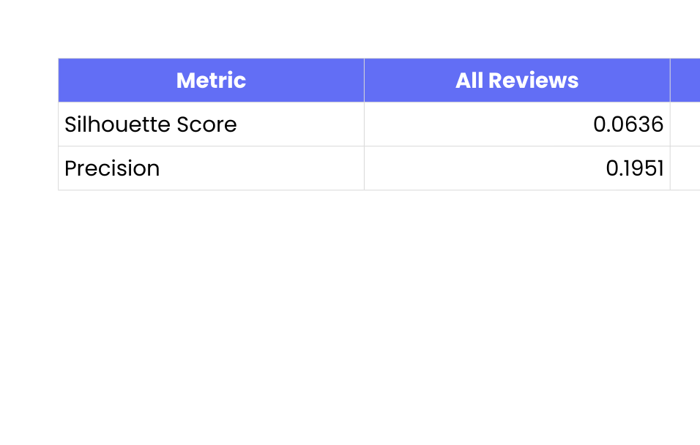
RQ1
Handling
MULTILINGUAL REVIEWS
Method and Results
Some reviews are written in languages other than Italian. To ensure consistent analysis, all non-Italian reviews are automatically translated into Italian using NLLB.
NLLB - No Language Left Behind
Machine translation
does not degrade
topic semantic quality!
Precision is computed by comparing the inferred taxonomy labels with the reference labels for each review. It measures the proportion of predicted labels that correctly match the reference label set.

Slide 12






RQ2
Comparative Evaluation of
STOPWORD STRATEGIES:
Method and Results
DOMAIN-SPECIFIC STOPWORD LIST
No Stopword Removal
Raw Banking
Reviews
TF-IDF
Vectorization
TF-IDF Stopword List
(Top 200)
Generic Stopword List
Language Detection &
Translation (Italian)
High-Frequency
Domain Terms
Domain-Specific Stopword Removal
Delta Stopwords (Domain – Generic)
Load Italian Stopwords from NLTK
Union Stopwords (Domain + Generic)
GENERIC STOPWORD LIST
[Stop Words for Processing Software Engineering Documents: Do they Matter?]

Slide 13
RQ2
Comparative Evaluation of
STOPWORD STRATEGIES:
Method and Results
Strategy | Silhouette | Topic Coherence | Topic Diversity
No Stopword Removal | 0.0636 | 0.5375 | 0.8071
Generic Stopword List | 0.0508 | 0.5313 | 0.8000
Domain-Specific Stopword Removal | 0.0427 | 0.4993 | 0.8786
Delta Stopword (Domain - Generic) | 0.0389 | 0.5044 | 0.8857
Union Stopword | 0.0434 | 0.5236 | 0.8714
[Results computed using the default approach based on UMAP and DBSCAN.]

Slide 14

Comparing MODELS
LDA
BERTopic
Probabilistic model where the document is a mixture of topics, topic as a distribution over words
Embedding-based model that uses transformer representations, HDBSCAN clustering and c-TF-IDF keyword extraction.
Topic Coherence Score: 0.6632
Topic Diversity Score: 0.3333
Topic Coherence Score: 0.5393
Topic Diversity Score: 0.8071
NMF
Matrix factorization of the document–term matrix into topic components.
Topic Coherence Score: 0.6190
Topic Diversity Score: 0.6867

Slide 15
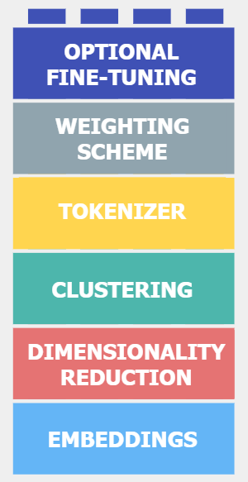
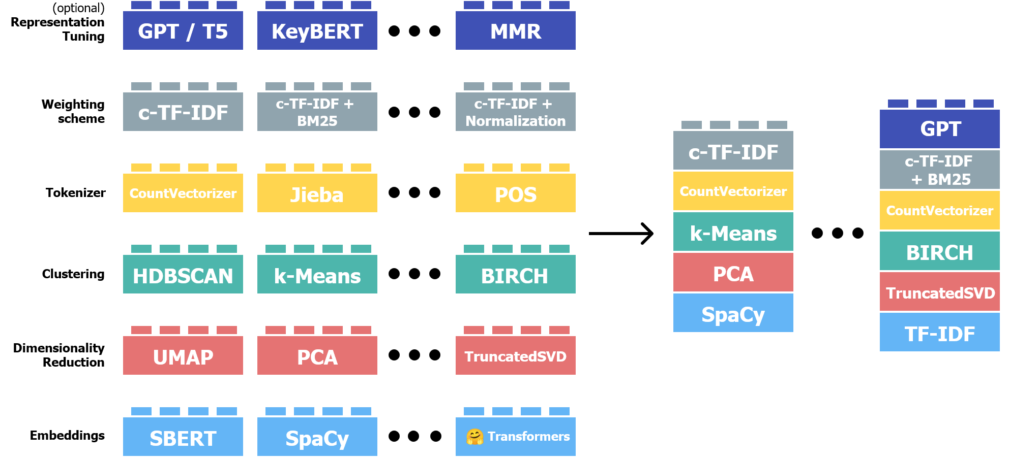
RQ3
BERTopic
Clustering | Dim. Reduction | Silhouette | Topic Coherence | Topic Diversity
HDBSCAN | UMAP | 0.0385 | 0.5393 | 0.8071
Spectral | Kernel PCA | -0.016 | 0.6919 | 0.5200
K-Means | Kernel PCA | 0.0345 | 0.5691 | 0.5267
Spectral | UMAP | 0.0198 | 0.5470 | 0.5733
K-Means | UMAP | 0.0147 | 0.05681 | 0.5400
Spectral
RESULTS
[Results computed using the default approach and hyperparamters, without stopword removal.]

Slide 16

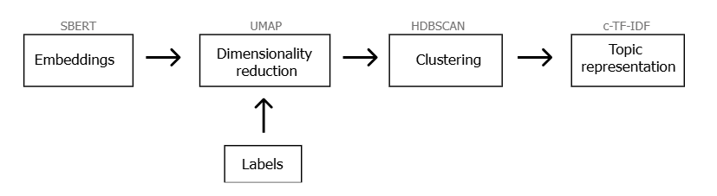








RQ4
Topic Modeling:
THREE APproaches COMPARED
TRADITIONAL
SEMI-SUPERVISED
The labels provides partial supervision by guiding the UMAP embedding space to bring documents with the same label closer
A subset of 15% of the reviews, labeled using the company’s system, is used as supervision.
Labels
GUIDED
Manually defined seed topics are provided to BERTopic to assign reviews to the most similar predefined topic.
During c-TF-IDF phase, seed words are upweighted to increase their prominence in topic representations.
"accedere”, "login", "password"
"assistenza", "supporto", "operatori"

Slide 17
RQ4
Topic Modeling:
THREE APproaches COMPARED
TRADITIONAL
Silhouette | Topic Coherence | Topic Diversity
0.0636 | 0.5375 | 0.8071
0.0559 | 0.5336 | 0.8071
0.0499 | 0.4969 | 0.8071
SEMI-SUPERVISED
Labels
GUIDED
"accedere”, "login", "password"
"assistenza", "supporto", "operatori"
[Results computed using the default architecture based on UMAP and DBSCAN, without stopword removal.]

Slide 18
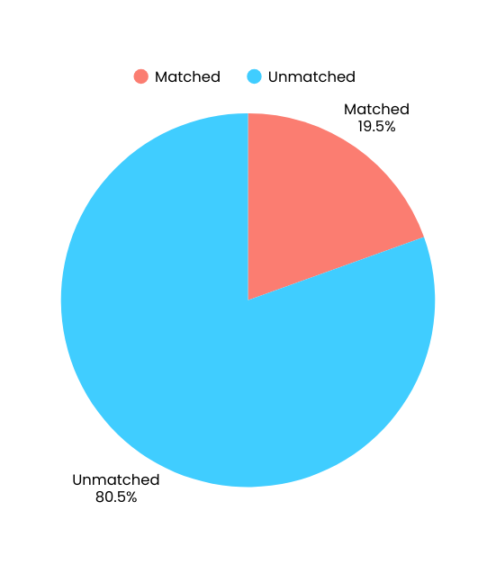

RQ5
Topic Taxonomy
ALIGNMENT RESULTS
Once taxonomy alignment is performed, alignment quality is assessed using a document-level precision metric, computed by measuring the overlap between the inferred taxonomy labels and the reference labels for each review.
Our Solution: ‘problemi_gestione_carta’
HYPE Reference: 'problemi_sistema'
Our Solution: ‘problemi_accesso’
HYPE Reference: 'problemi_accesso'
Our Solution: ‘problemi_sistema’
HYPE Reference: 'problemi_accesso'
Since the HYPE labels are generated automatically or
manually, a qualitative check allows the identification
of cases where the label is marked as incorrect
by the metric, but the assignment is accurate.
[Results computed with the single-label assignment using the best configuration, according to the evaluation metrics.]

Slide 19
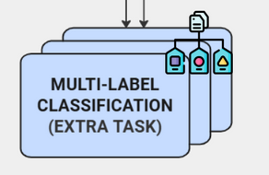
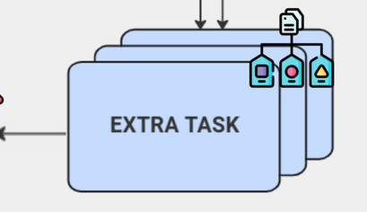




EXTRA TASKS
Multi-Label Classification
Some reviews cover more than one issue.
For each review, we use BERTopic’s topic probability distribution.
Up to three topics are assigned when their probability is ≥ 85% of the top score.
OUTLIERS
App Update Issues:
Support Issues:
P= 0.1301
P= 0.1178
Outlier [Topic: -1]
Reassign the review
to that topic
The initial topic modeling output produced a high number of outliers, so the same approach was applied to reduce them.
Any topic score > 20% ?
Keep the review
as outlier

Slide 20


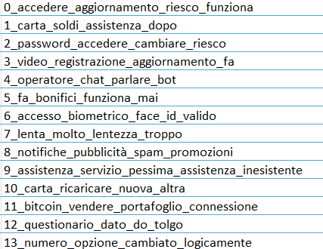

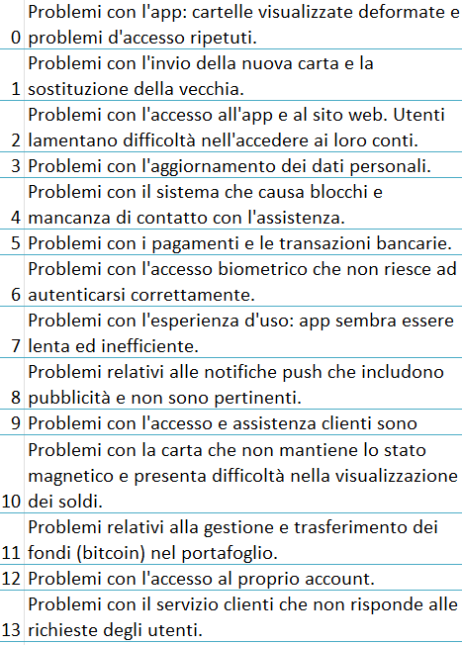
BEST CONFIGURATION
Architecture: UMAP + HDBSCAN
Stop-word strategy: None
Topic modeling approach: Traditional
Number of topics: Fixed to 14
Outliers reduction
Silhouette | Topic Coherence | Topic Diversity | Outliers
0.0636 | 0.5375 | 0.8071 | 19.12%
UMAP (n_neighbors = 20, n_components = 5, min_dist = 0.0, metrcic = “cosine”)
HDBSCAN (min_cluster_size = 20, min_samples = 5)
LLM

Slide 21



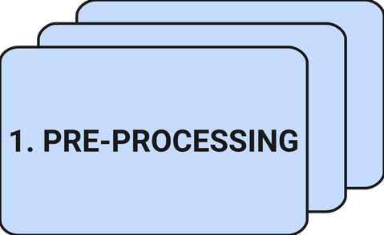
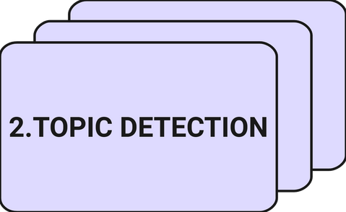
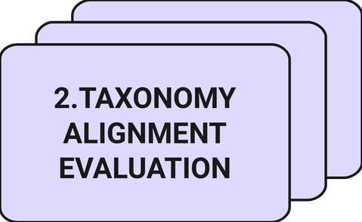
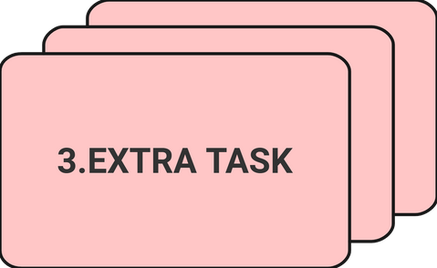

SUMMARY OF KEY POINTS
Standard cleaning, neutral review reclassification, stopword strategy evaluation and machine translation impact analysis.
BERTopic was compared with LDA and NMF across multiple architectures and modeling strategies.
Discovered topics were mapped to the HYPE taxonomy using embedding-based cosine similarity and evaluated through precision and qualitative inspection.
Multi-label classification was also used for outlier reduction.

Slide 22
for
your attention!
THANK YOU
Alessia Ciccaglione - s344499
Amirhossein Lotf Ranaei - s323336
Sonia Foco - s343043

